Slide 1














Ecommerce and WEB Engineering
Presentation
Presented By Group 09

Slide 2
Question 03
Topic Overview
01
02
03
04
A Website Containing Cascading Style Sheets
CSS with formatted Text
Site Must Contain Forms And Tables
Use three ways to insert CSS
(Internal,External and inline CSS)

Slide 3
01.
Visual Studio Code
Project Instruments
Chrome,Firefox,Edge or Safari Browser
02.
Live Server Extension(VS Code)
03.

Slide 4

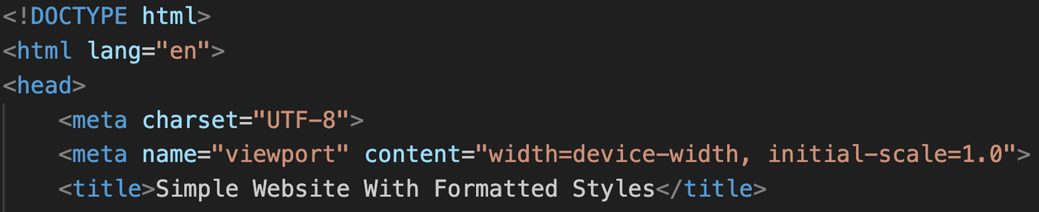
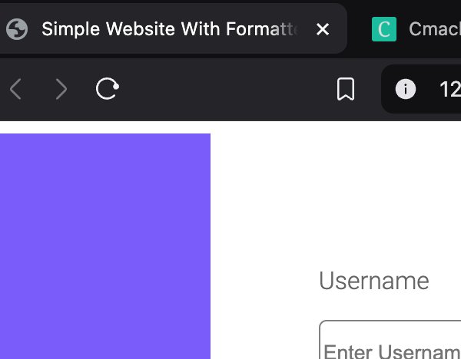
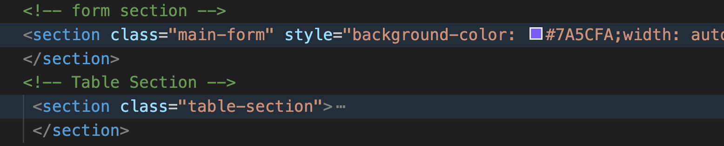
Creating title and Two Sections
Input
Output

Slide 5
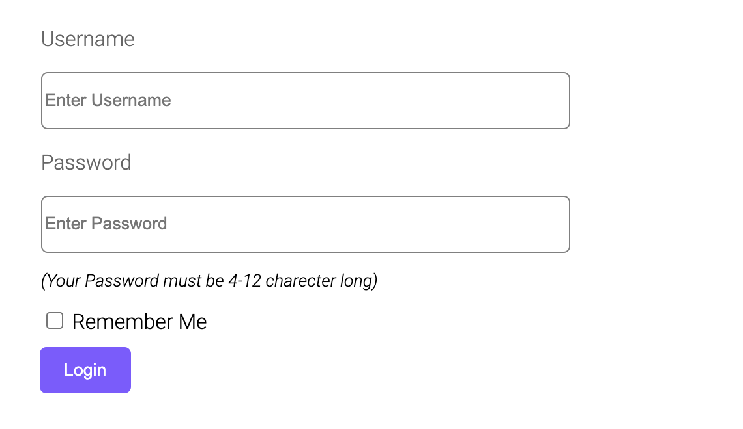
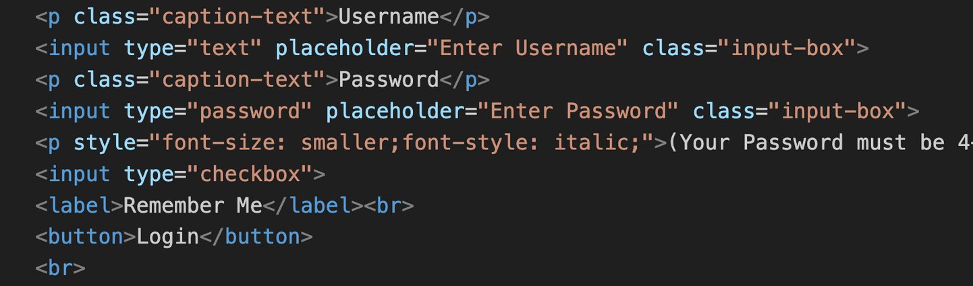
Creating Forms and Buttons
Input
Output

Slide 6
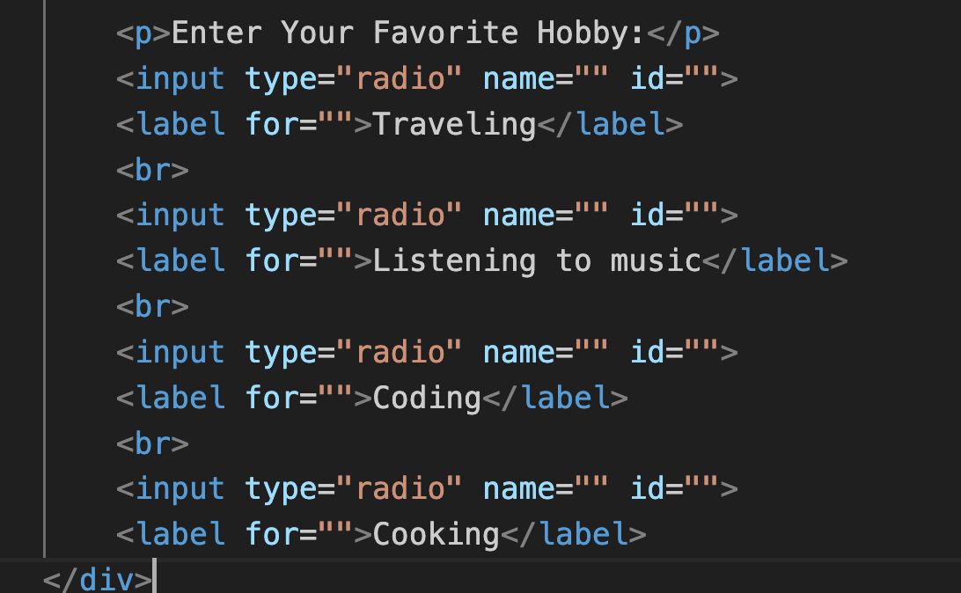
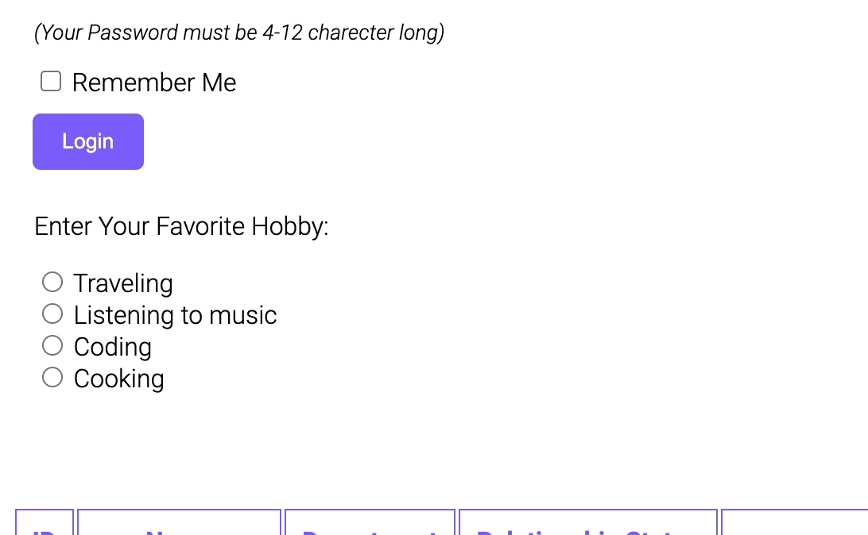
Adding Radio Buttons and Checkboxes
Input
Output

Slide 7
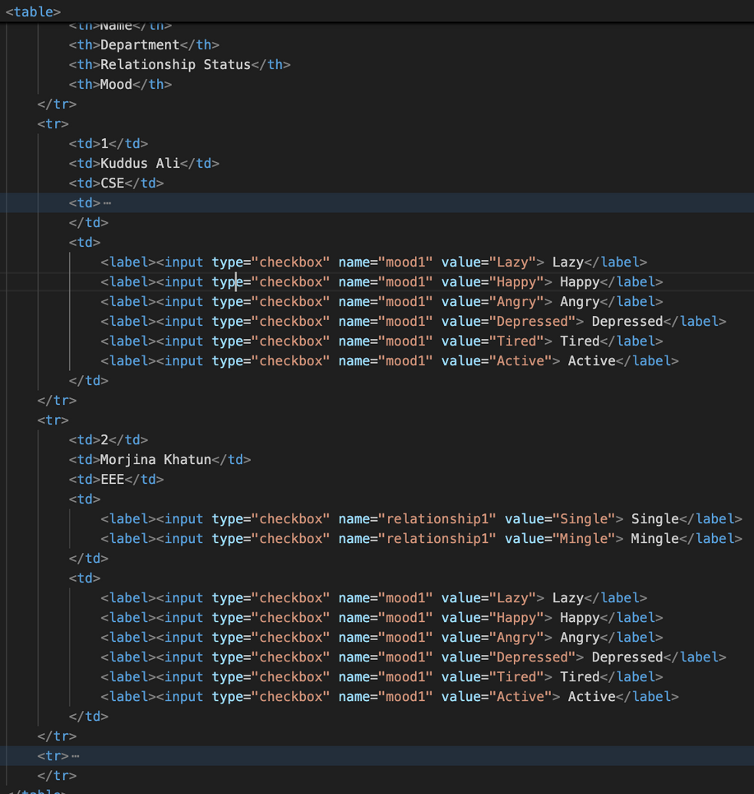
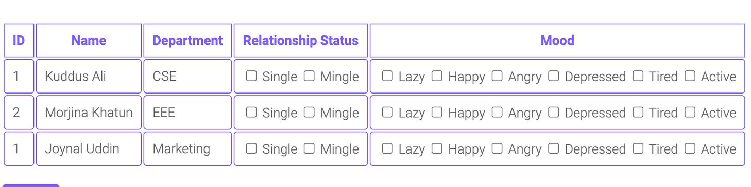
Creating A Table
Input
Output

Slide 8
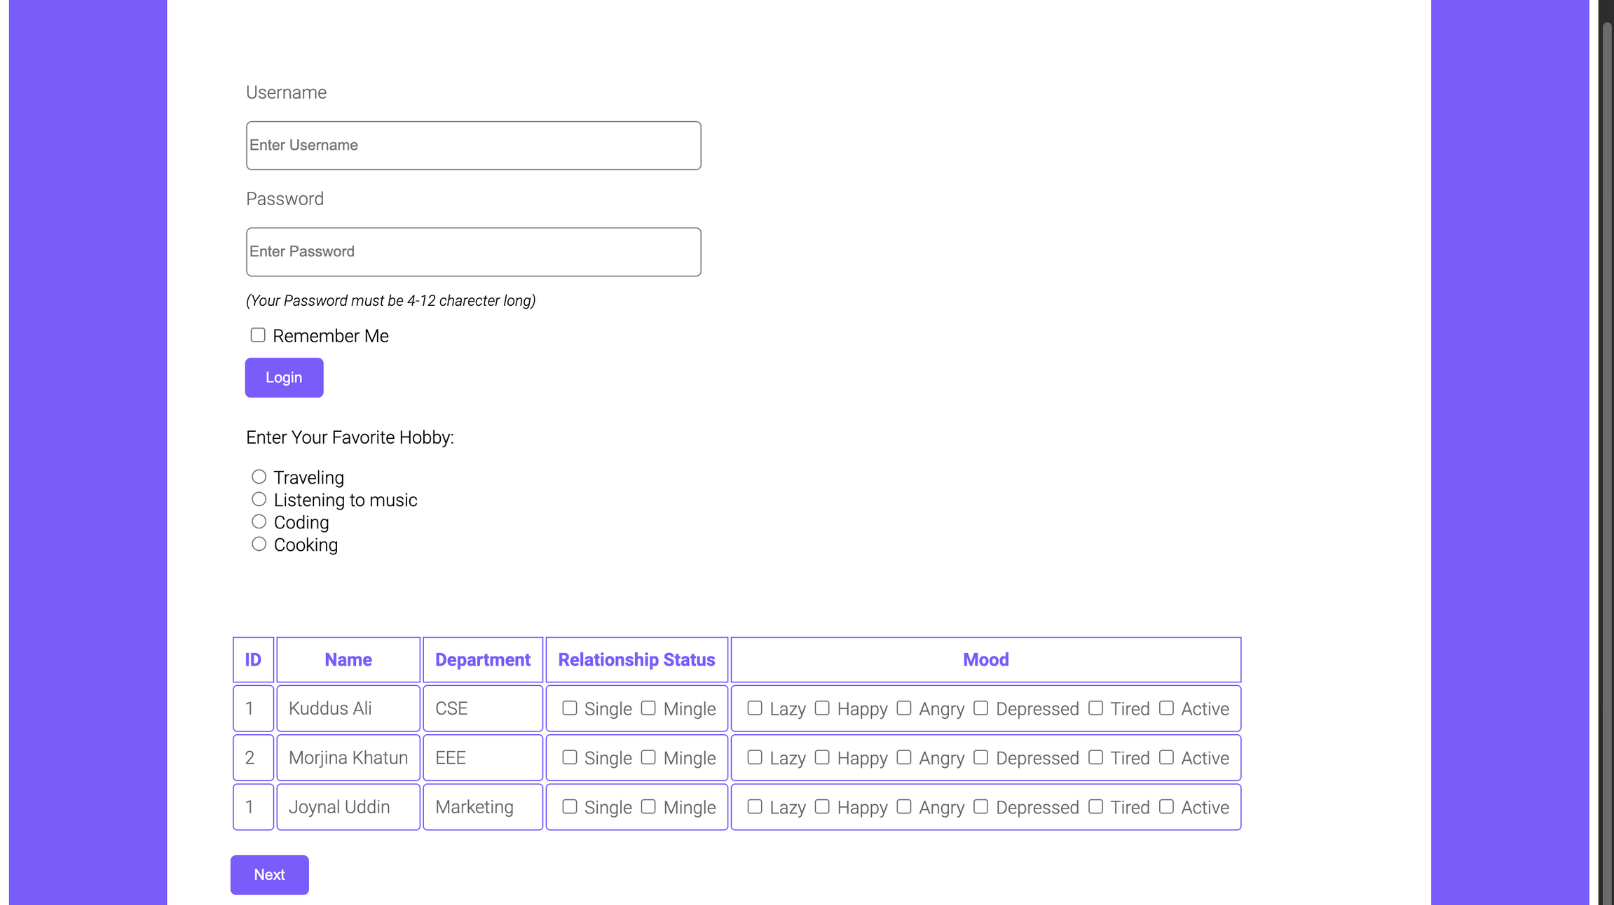
Final Result

Slide 9
Thank you very much!
Powered By Tusher Kana Podder
CSE,NMDC

